Slide 1
CLICKSTREAM ANALYSIS FOR CROWD-BASED OBJECT SEGMENTATION WITH CONFIDENCE
CLICKSTREAM ANALYSIS FOR CROWD BASED OBJECT SEGMENTATION WITH CONFIDENCE
DEEPUL NAIR
Class No:23 S7 B-Tech CSE
Dept. of CSE, MACE Kothamangalam
November,2018

Slide 2
CONTENTS
CLICKSTREAM ANALYSIS FOR CROWD BASED OBJECT SEGMENTATION WITH CONFIDENCE
Introduction
Related Work
Proposed method
Result and Discussions
Conclusion
References
Dept. of CSE, MACE Kothamangalam

Slide 3
INTRODUCTION
CLICKSTREAM ANALYSIS FOR CROWD BASED OBJECT SEGMENTATION WITH CONFIDENCE
Image Annotations
Computer Vision
Biomedical Image Processing
Control under water vehicles
What is bottleneck issue affecting it?
Dept. of CSE, MACE Kothamangalam

Slide 4
Crowd Sourcing
CLICKSTREAM ANALYSIS FOR CROWD BASED OBJECT SEGMENTATION WITH CONFIDENCE
Outsourcing cognitive works
Innovation
Problem Solving
Efficiency
Practice of engaging crowed for common goal
Done via Internet
Dept. of CSE, MACE Kothamangalam

Slide 5
Clickstream Analysis
CLICKSTREAM ANALYSIS FOR CROWD BASED OBJECT SEGMENTATION WITH CONFIDENCE
Process of collecting, analyzing and reporting aggregate data
Traffic analytics
Data analytics
Understand User behaviour
Done via mousestrokes
Dept. of CSE, MACE Kothamangalam
Notes:
process of collecting, analyzing and reporting aggregate data traffic analytics

Slide 6
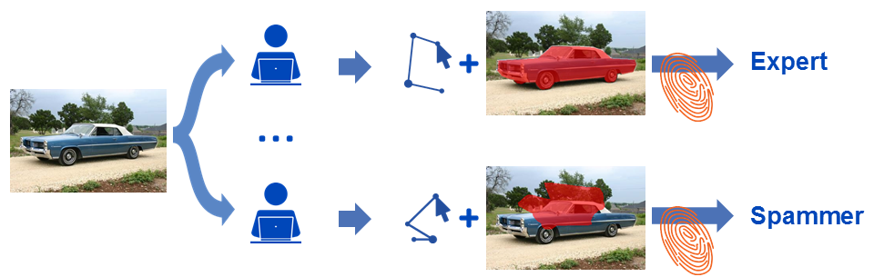
Problem
CLICKSTREAM ANALYSIS FOR CROWD BASED OBJECT SEGMENTATION WITH CONFIDENCE
Rise of algorithms for annotations
Large amount of training data
Spamming
Quality control
Dept. of CSE, MACE Kothamangalam

Slide 7
Related Works
CLICKSTREAM ANALYSIS FOR CROWD BASED OBJECT SEGMENTATION WITH CONFIDENCE
Integration of reference data into annotation
Pairing unknown label with reference label
Data consensus is taken
Relies on reference data
Do not consider the quality
Dept. of CSE, MACE Kothamangalam

Slide 8
Related Works
CLICKSTREAM ANALYSIS FOR CROWD BASED OBJECT SEGMENTATION WITH CONFIDENCE
Majority Voting
Multiple labels are taken and ranked against acquired ones
Provides solution close to optimum
Results in large amount of data required from crowd
Dept. of CSE, MACE Kothamangalam
Notes:
detect low-quality labels is to acquire
multiple labels from each sample and rank them against the
majority of the acquired labelsprovide
solutions close to the optima

Slide 9
Related Works
CLICKSTREAM ANALYSIS FOR CROWD BASED OBJECT SEGMENTATION WITH CONFIDENCE
Automatic annotation quality estimation
Derived features from images
Parameters obtained from contour
Expectation Maximization method is used for confidence
Dept. of CSE, MACE Kothamangalam
Notes:
detect low-quality labels is to acquire
multiple labels from each sample and rank them against the
majority of the acquired labelsprovide
solutions close to the optimafeatures derived from the image
itself (e.g. image edges) and parameters obtained from the
resulting annotation contour or segmentation

Slide 10
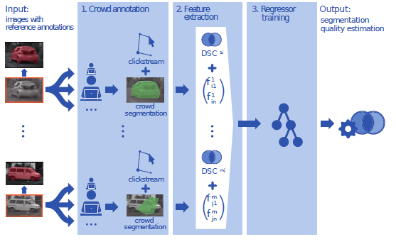
Proposed System
CLICKSTREAM ANALYSIS FOR CROWD BASED OBJECT SEGMENTATION WITH CONFIDENCE
Courtesy:https://ieeexplore.ieee.org/document/8120128
Dept. of CSE, MACE Kothamangalam
Notes:
detect low-quality labels is to acquire
multiple labels from each sample and rank them against the
majority of the acquired labelsprovide
solutions close to the optimafeatures derived from the image
itself (e.g. image edges) and parameters obtained from the
resulting annotation contour or segmentation

Slide 11
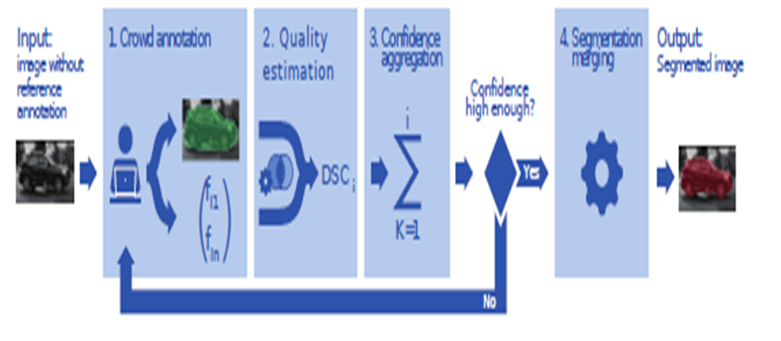
Proposed System
CLICKSTREAM ANALYSIS FOR CROWD BASED OBJECT SEGMENTATION WITH CONFIDENCE
Courtesy:https://ieeexplore.ieee.org/document/8120128
Dept. of CSE, MACE Kothamangalam
Notes:
detect low-quality labels is to acquire
multiple labels from each sample and rank them against the
majority of the acquired labelsprovide
solutions close to the optimafeatures derived from the image
itself (e.g. image edges) and parameters obtained from the
resulting annotation contour or segmentation

Slide 12
Clickstream Data Collection
CLICKSTREAM ANALYSIS FOR CROWD BASED OBJECT SEGMENTATION WITH CONFIDENCE
Every action is triggered by mouse action by event types:
Mouse UP
Mouse Down
Mouse wheel
Double click
Dept. of CSE, MACE Kothamangalam
Notes:
detect low-quality labels is to acquire
multiple labels from each sample and rank them against the
majority of the acquired labelsprovide
solutions close to the optimafeatures derived from the image
itself (e.g. image edges) and parameters obtained from the
resulting annotation contour or segmentation

Slide 13
Feature Extraction
CLICKSTREAM ANALYSIS FOR CROWD BASED OBJECT SEGMENTATION WITH CONFIDENCE
Velocity
Accerlation
Zoom
Canvas click
Ratio of traveled mouse distance and contour
Dept. of CSE, MACE Kothamangalam
Notes:
detect low-quality labels is to acquire
multiple labels from each sample and rank them against the
majority of the acquired labelsprovide
solutions close to the optimafeatures derived from the image
itself (e.g. image edges) and parameters obtained from the
resulting annotation contour or segmentation

Slide 14
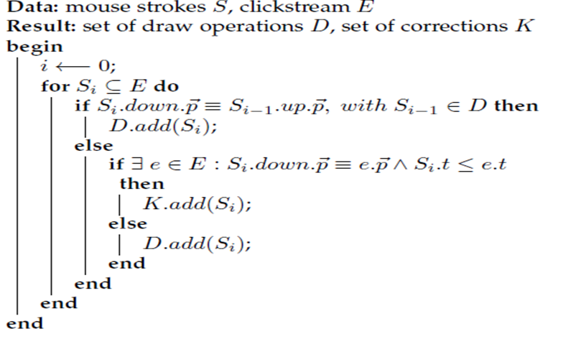
Draw Operations
CLICKSTREAM ANALYSIS FOR CROWD BASED OBJECT SEGMENTATION WITH CONFIDENCE
Dept. of CSE, MACE Kothamangalam
Notes:
detect low-quality labels is to acquire
multiple labels from each sample and rank them against the
majority of the acquired labelsprovide
solutions close to the optimafeatures derived from the image
itself (e.g. image edges) and parameters obtained from the
resulting annotation contour or segmentation

Slide 15


Image based Feature
CLICKSTREAM ANALYSIS FOR CROWD BASED OBJECT SEGMENTATION WITH CONFIDENCE
Use of image gradient and angle
Normalizing velocity:
Compute the angle
Dept. of CSE, MACE Kothamangalam
Notes:
detect low-quality labels is to acquire
multiple labels from each sample and rank them against the
majority of the acquired labelsprovide
solutions close to the optimafeatures derived from the image
itself (e.g. image edges) and parameters obtained from the
resulting annotation contour or segmentation

Slide 16

Feature Extraction
CLICKSTREAM ANALYSIS FOR CROWD BASED OBJECT SEGMENTATION WITH CONFIDENCE
The mean,median and standard deviation of angles are taken
The interpolated line segment is taken
Dept. of CSE, MACE Kothamangalam
Notes:
detect low-quality labels is to acquire
multiple labels from each sample and rank them against the
majority of the acquired labelsprovide
solutions close to the optimafeatures derived from the image
itself (e.g. image edges) and parameters obtained from the
resulting annotation contour or segmentation

Slide 17


Estimation of image Quality
CLICKSTREAM ANALYSIS FOR CROWD BASED OBJECT SEGMENTATION WITH CONFIDENCE
Takes the DSC value of the feature
Confidence is then calculated
Dept. of CSE, MACE Kothamangalam
Notes:
detect low-quality labels is to acquire
multiple labels from each sample and rank them against the
majority of the acquired labelsprovide
solutions close to the optimafeatures derived from the image
itself (e.g. image edges) and parameters obtained from the
resulting annotation contour or segmentation

Slide 18
Validation
CLICKSTREAM ANALYSIS FOR CROWD BASED OBJECT SEGMENTATION WITH CONFIDENCE
The regressor is trained with features
Training set :PASCAL Visual Object Classes
The estimation is quantified : difference in DSC values
Filter methods used to find optimal
Methods used are CMIM,ICAP etc
Confidence is then calculated
Dept. of CSE, MACE Kothamangalam
Notes:
detect low-quality labels is to acquire
multiple labels from each sample and rank them against the
majority of the acquired labelsprovide
solutions close to the optimafeatures derived from the image
itself (e.g. image edges) and parameters obtained from the
resulting annotation contour or segmentation

Slide 19
Generalization
CLICKSTREAM ANALYSIS FOR CROWD BASED OBJECT SEGMENTATION WITH CONFIDENCE
Implemented by OpenLayer and Amazon Mechanical Turk
The Object classes are extended
Acquired 1000 annotations
Filter methods used to find optimal
Methods used are CMIM,ICAP etc
Dept. of CSE, MACE Kothamangalam
Notes:
detect low-quality labels is to acquire
multiple labels from each sample and rank them against the
majority of the acquired labelsprovide
solutions close to the optimafeatures derived from the image
itself (e.g. image edges) and parameters obtained from the
resulting annotation contour or segmentation

Slide 20
Confidence weighted merging
CLICKSTREAM ANALYSIS FOR CROWD BASED OBJECT SEGMENTATION WITH CONFIDENCE
Compared with STAPLE algorithm
The high quality is used for merging
The low quality is filtered
Dept. of CSE, MACE Kothamangalam
Notes:
detect low-quality labels is to acquire
multiple labels from each sample and rank them against the
majority of the acquired labelsprovide
solutions close to the optimafeatures derived from the image
itself (e.g. image edges) and parameters obtained from the
resulting annotation contour or segmentation

Slide 21


Annotation Cost
CLICKSTREAM ANALYSIS FOR CROWD BASED OBJECT SEGMENTATION WITH CONFIDENCE
Cost is calculated
s
Manual Cost
Dept. of CSE, MACE Kothamangalam
Notes:
detect low-quality labels is to acquire
multiple labels from each sample and rank them against the
majority of the acquired labelsprovide
solutions close to the optimafeatures derived from the image
itself (e.g. image edges) and parameters obtained from the
resulting annotation contour or segmentation

Slide 22
Result and Discussions
CLICKSTREAM ANALYSIS FOR CROWD BASED OBJECT SEGMENTATION WITH CONFIDENCE
High Improvement of values in segmentation
With good DSC value; low quality is omitted
The mean angle, interpolated region and gradient is important features of data set
For estimation accuracy:median mouse velocity
Dept. of CSE, MACE Kothamangalam
Notes:
detect low-quality labels is to acquire
multiple labels from each sample and rank them against the
majority of the acquired labelsprovide
solutions close to the optimafeatures derived from the image
itself (e.g. image edges) and parameters obtained from the
resulting annotation contour or segmentation

Slide 23
Result and Discussions
CLICKSTREAM ANALYSIS FOR CROWD BASED OBJECT SEGMENTATION WITH CONFIDENCE
Generalization capability: high performance
Segmentation cost: outperforms conventional methods and least expensive
Dept. of CSE, MACE Kothamangalam
Notes:
detect low-quality labels is to acquire
multiple labels from each sample and rank them against the
majority of the acquired labelsprovide
solutions close to the optimafeatures derived from the image
itself (e.g. image edges) and parameters obtained from the
resulting annotation contour or segmentation

Slide 24
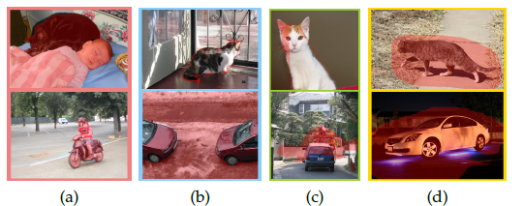
Image Quality
CLICKSTREAM ANALYSIS FOR CROWD BASED OBJECT SEGMENTATION WITH CONFIDENCE
Courtesy:https://ieeexplore.ieee.org/document/8120128
Dept. of CSE, MACE Kothamangalam
Notes:
detect low-quality labels is to acquire
multiple labels from each sample and rank them against the
majority of the acquired labelsprovide
solutions close to the optimafeatures derived from the image
itself (e.g. image edges) and parameters obtained from the
resulting annotation contour or segmentation

Slide 25
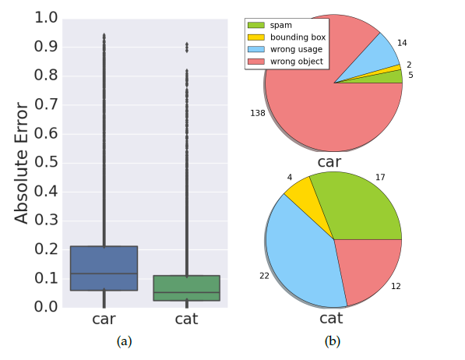
Estimation Analysis
CLICKSTREAM ANALYSIS FOR CROWD BASED OBJECT SEGMENTATION WITH CONFIDENCE
Courtesy:https://ieeexplore.ieee.org/document/8120128
Dept. of CSE, MACE Kothamangalam
Notes:
detect low-quality labels is to acquire
multiple labels from each sample and rank them against the
majority of the acquired labelsprovide
solutions close to the optimafeatures derived from the image
itself (e.g. image edges) and parameters obtained from the
resulting annotation contour or segmentation

Slide 26
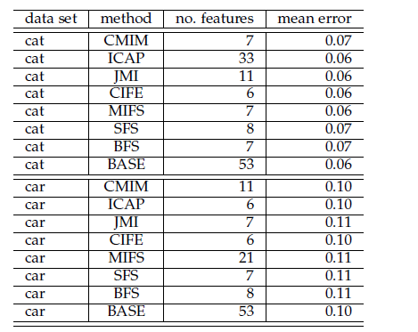
MEAN ESTIMATION OF FEATURE
CLICKSTREAM ANALYSIS FOR CROWD BASED OBJECT SEGMENTATION WITH CONFIDENCE
Courtesy:https://ieeexplore.ieee.org/document/8120128
Dept. of CSE, MACE Kothamangalam
Notes:
detect low-quality labels is to acquire
multiple labels from each sample and rank them against the
majority of the acquired labelsprovide
solutions close to the optimafeatures derived from the image
itself (e.g. image edges) and parameters obtained from the
resulting annotation contour or segmentation

Slide 27
CONCLUSION
CLICKSTREAM ANALYSIS FOR CROWD BASED OBJECT SEGMENTATION WITH CONFIDENCE
Clickstream features are very good predictor for segmentation quality
The features generalize over similar classes
Can be applied for confidence based annotations
Dept. of CSE, MACE Kothamangalam
Notes:
detect low-quality labels is to acquire
multiple labels from each sample and rank them against the
majority of the acquired labelsprovide
solutions close to the optimafeatures derived from the image
itself (e.g. image edges) and parameters obtained from the
resulting annotation contour or segmentation

Slide 28
References
CLICKSTREAM ANALYSIS FOR CROWD BASED OBJECT SEGMENTATION WITH CONFIDENCE
A. Luckow, K. Kennedy, F. Manhardt, E. Djerekarov, B. Vorster, and A. Apon, “Automotive big data: Applications, workloads and infrastructures,” in Proc. IEEE International Conference on Big Data (Big Data), pp. 1201–1210, 2015.
J. Deng, W. Dong, R. Socher, L.-J. Li, K. Li, and L. Fei-Fei, “Ima-geNet: A Large-Scale Hierarchical Image Database,” in Proc. IEEE Conference on Computer Vision and Pattern Recognition, 2009.
L. Zhou, L. Wang, Q. Wang, and Y. Shi, eds., Machine Learning in Medical Imaging, vol. LNCS 9352, 2015.
A. Krizhevsky, I. Sutskever, and G. E. Hinton, “Imagenet classifi-cation with deep convolutional neural networks,” in Advances in Neural Information Processing Systems, pp. 1097–1105, 2012.
S. Albarqouni, C. Baur, F. Achilles, V. Belagiannis, S. Demirci, and N. Navab, “Aggnet: Deep learning from crowds for mitosis detection in breast cancer histology images,” IEEE Transactions on Medical Imaging, vol. 35, no. 5, pp. 1313–1321, 2016.
Dept. of CSE, MACE Kothamangalam
Notes:
detect low-quality labels is to acquire
multiple labels from each sample and rank them against the
majority of the acquired labelsprovide
solutions close to the optimafeatures derived from the image
itself (e.g. image edges) and parameters obtained from the
resulting annotation contour or segmentation

Slide 29
THANK YOU
CLICKSTREAM ANALYSIS FOR CROWD BASED OBJECT SEGMENTATION WITH CONFIDENCE
Dept. of CSE, MACE Kothamangalam

